Slide 1
Dig_IT
Air Quality data

Slide 2
Table of contents
Data overview
Data visualization
Data pre-process
Forecasting
Problem description
Proposed methodology: Statistical analysis
Examples

Slide 3
Data overview
Retrieved data
Source: Thingspeak.com
ID: kobra1@online.no
Password: DigIT2022
Features
Temperature
Humidity
PM2.5
PM10
CO
NO2
NH3
Note
Only data from 7-kanal-1 are calibrated

Slide 4
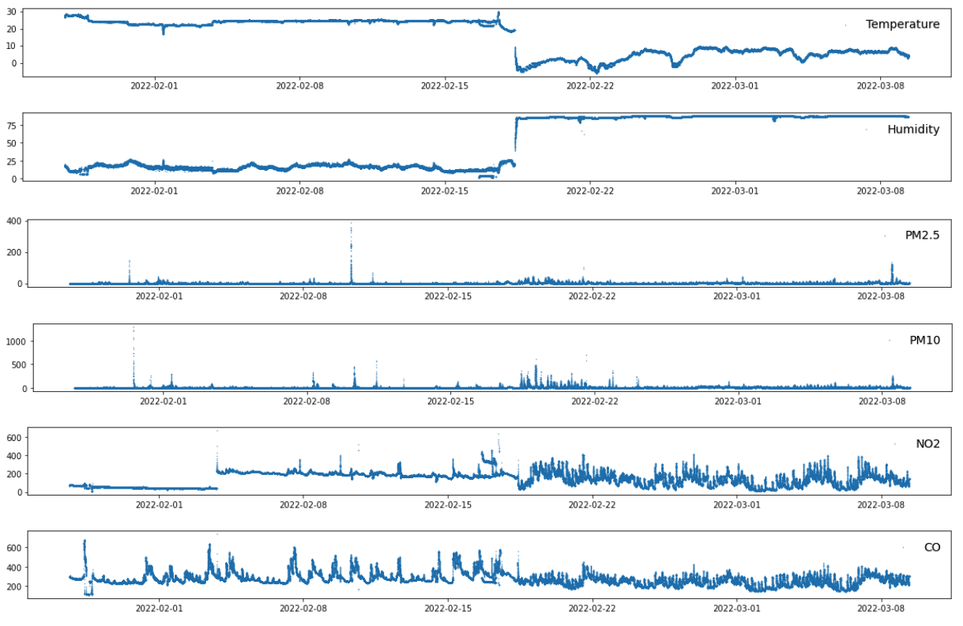
Data visualization & pre-process
Pre-process
Temperature and Humidity present strange behavior. From this stage, they are not considered for further analysis.
Remove NO₂ records before '2022-01-27 16:12:40' - Not valid values, Not calibrated sensors
Replace negative values with NaN
Outlier removal – Method: STD

Slide 5
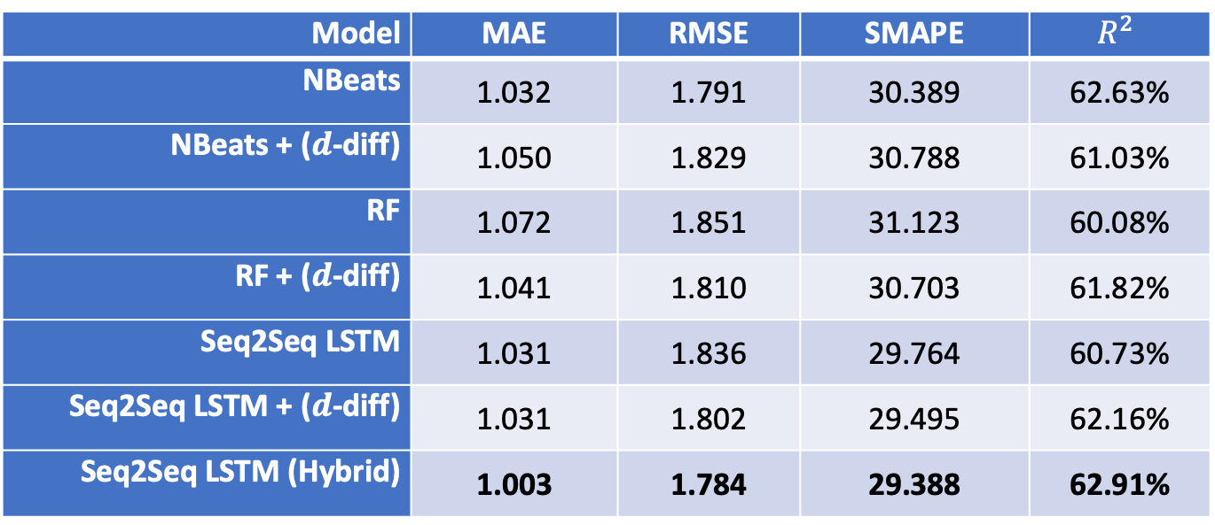
Experimental results – Forecasting PM2.5
Model | MAE | RMSE | SMAPE | $$R^{2}$$
NBeats | 1.032 | 1.791 | 30.389 | 62.63%
NBeats + ($d$-diff) | 1.050 | 1.829 | 30.788 | 61.03%
RF | 1.072 | 1.851 | 31.123 | 60.08%
RF + ($d$-diff) | 1.041 | 1.810 | 30.703 | 61.82%
Seq2Seq LSTM | 1.031 | 1.836 | 29.764 | 60.73%
Seq2Seq LSTM + ($d$-diff) | 1.031 | 1.802 | 29.495 | 62.16%
Seq2Seq LSTM (Hybrid) | 1.003 | 1.784 | 29.388 | 62.91%
Performance evaluation
Questions:
Which is the best model?
Is it possible for all model to perform similarly?

Slide 6
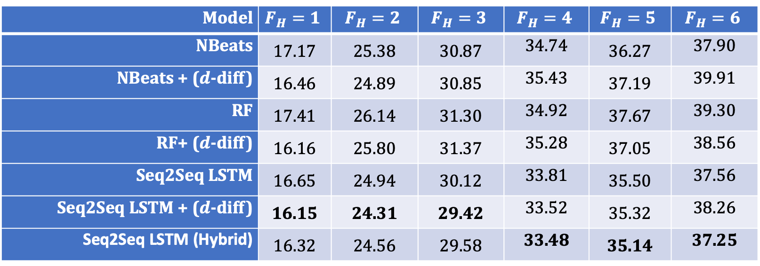
Experimental results – Forecasting PM2.5
Model | $$F_{H}=1$$ | $$F_{H}=2$$ | $$F_{H}=3$$ | $$F_{H}=4$$ | $$F_{H}=5$$ | $$F_{H}=6$$
NBeats | 17.17 | 25.38 | 30.87 | 34.74 | 36.27 | 37.90
NBeats + ($d$-diff) | 16.46 | 24.89 | 30.85 | 35.43 | 37.19 | 39.91
RF | 17.41 | 26.14 | 31.30 | 34.92 | 37.67 | 39.30
RF+ ($d$-diff) | 16.16 | 25.80 | 31.37 | 35.28 | 37.05 | 38.56
Seq2Seq LSTM | 16.65 | 24.94 | 30.12 | 33.81 | 35.50 | 37.56
Seq2Seq LSTM + ($d$-diff) | 16.15 | 24.31 | 29.42 | 33.52 | 35.32 | 38.26
Seq2Seq LSTM (Hybrid) | 16.32 | 24.56 | 29.58 | 33.48 | 35.14 | 37.25
sMAPE for each value of forecasting horizon $\left(F_{H}\right)$
Questions:
Which is the best model?
Is it possible for all model to perform similarly?

Slide 7
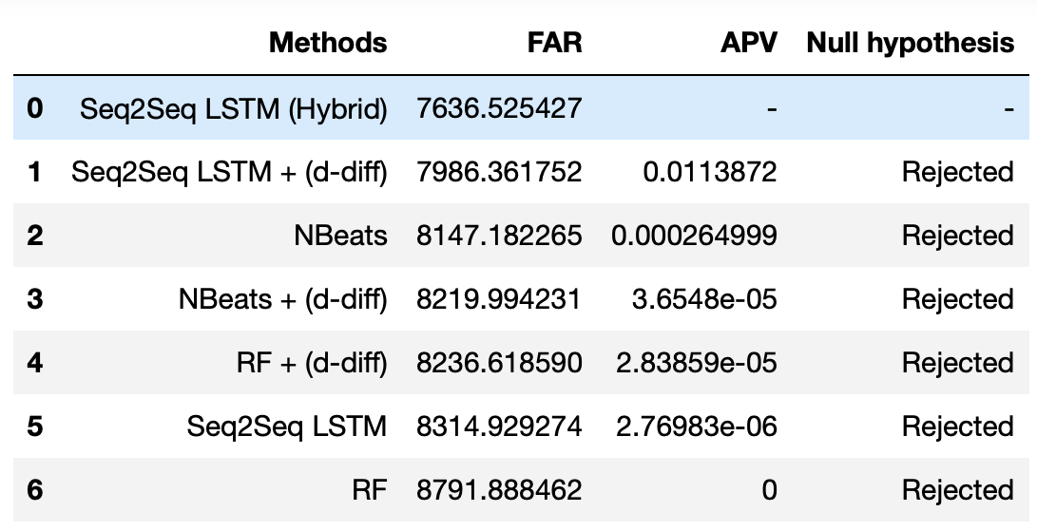
Experimental results – Forecasting PM2.5
Null hypothesis: Are the compared methods equivalent?
Answers:
Which is the best model? Seq2Seq LSTM + (Hybrid)
Is it possible for all model to perform similarly? No

Slide 8
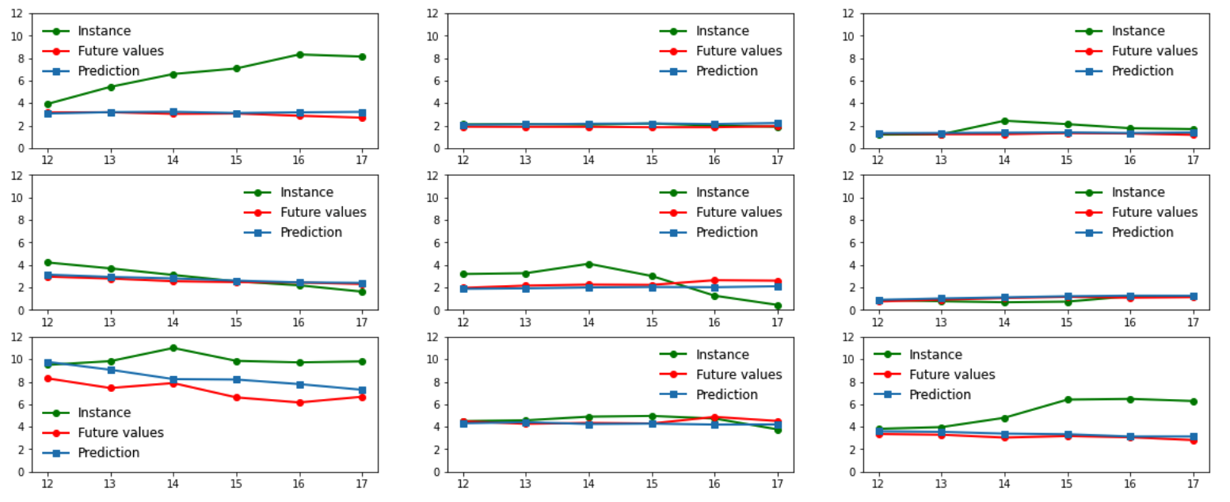
Forecasting Examples
Comparison: RF - Seq2Seq LSTM (Hybrid)

Slide 9
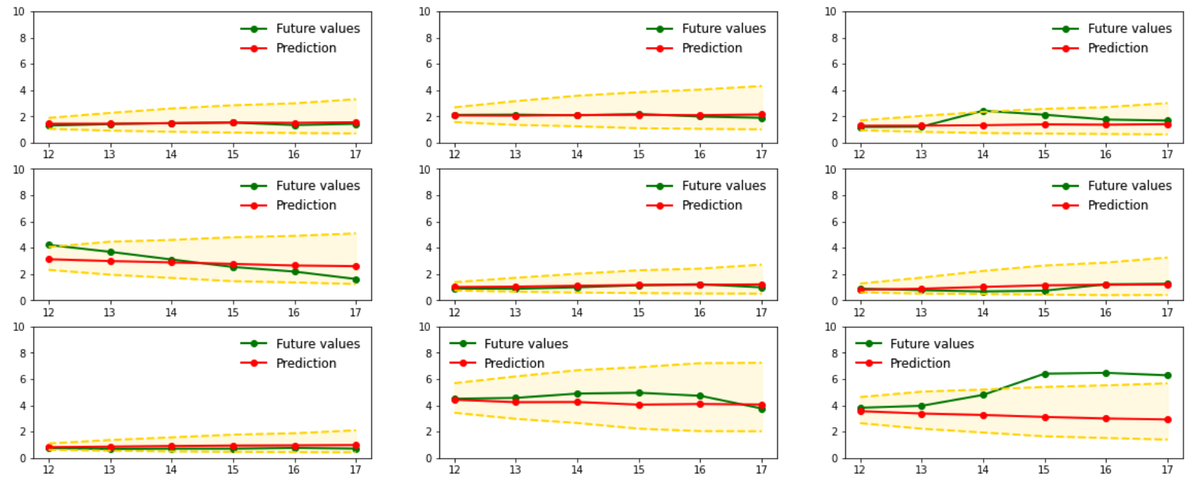
Forecasting Examples
Model: Seq2Seq LSTM (Hybrid) + Confidence intervals

Slide 10
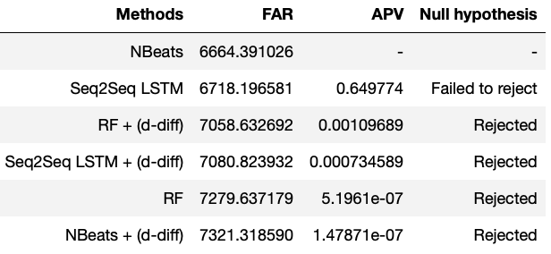
Experimental results – Forecasting PM10
Null hypothesis: Are the compared methods equivalent?
Answers:
Which is the best model? NBeats
Is it possible for all model to perform similarly? No

